Slide 1
CHAPTER 7 · LECTURES 13 & 14
The ₹308 Crore
Question
Demand forecasting, told through one dark store, one heatwave,
one banned noodle and one $100 million pair of sneakers.

Slide 2
₹308 crore
was thrown in the bin.
In one quarter. By one company. In India.
The cold open
2

Slide 3
THE NUMBER
Blinkit's inventory loss, Q1 FY27
2,443
dark stores operating at the end of the quarter
1.8%
₹8.27 lakh
of goods sold per store, per day
of Net Order Value written off as inventory loss —
about ₹308 crore for the quarter.
₹518
net average order value
Management attributed the losses primarily to perishable products.
31.8 million
customers transacting every month
That ₹308 crore is not theft and not fraud. It is bananas that browned, curd that expired and bread nobody bought — the cash value of a forecast that was wrong.
Source: Eternal Ltd Q1 FY27 earnings call, as reported by MediaNama (July 2026).
Demand Forecasting
3

Slide 4
YOUR NEW JOB
You run dark store #2,443
You are the demand planner for one 2,500 sq ft dark store. Nobody shops there. It has no windows and no billboard. Riders walk in, pick, and leave in ninety seconds.
Order too much
Perishables expire. You write off stock at full cost. Your store joins the ₹308 crore.
Every night at 11 p.m. you do exactly one thing:
Order too little
You tell the warehouse how many units of each of ~6,000 items
to send you for tomorrow.
The app shows "out of stock". The customer closes it and opens Zepto. You may not get them back.
??: Both errors cost money. Which one would you rather make — and does your answer change if the item is bananas instead of batteries?
Demand Forecasting
4

Slide 5
Seven times the forecast broke
1
The store has no history at all
Qualitative methods
We are opening in Guna next month. Zero data.
2
We need to plan riders for next year
Simple linear regression
Six quarters of orders. Fit a line, extend it.
3
Management wants to raise the delivery fee
Causal regression
Demand is driven by price, not by the calendar.
4
April arrives and ice cream explodes
Time series & seasonal index
The trend line is right on average and wrong every month.
5
A regulator bans our best-selling product
Irregular variation
No model predicts the Maggi ban.
6
It is Tuesday and it is 44°C
Moving average & smoothing
Nothing annual helps you decide tonight.
7
We buy a $400 million forecasting system
Choosing the method
Nike did. It cost them $100 million.
Demand Forecasting
5

Slide 6
01
THE GROUND FLOOR
What a Forecast
Actually Is
Before the formulas: what you are estimating, and every decision downstream that inherits your error.
Demand Forecasting
6

Slide 7
DEFINITION
Demand Forecasting
Demand forecasting is estimating how much of a product or service customers will want — and when they will want it.
It is a range, not a number
It is the first domino
It will be wrong
A forecast without a stated margin of error invites false confidence. "180 ± 25 tubs" is a forecast; "180 tubs" is a guess in a suit.
Capacity, staffing, purchasing, working capital and pricing are all built on top of it. Each one inherits its error.
The only question is by how much, in which direction, and whether you noticed in time to correct it.
??: Your store forecasts 180 tubs of ice cream and sells 176. Was the forecast good? Now: it forecasts 180 and sells 176, but 60 of those were sold in the first hour and the rest of the day showed "out of stock". Same total. Same forecast quality?
Demand Forecasting
7

Slide 8
WHY IT MATTERS
Six decisions that inherit your error
1
Production / procurement
2
Planning & scheduling
3
Acquiring inputs
How many crates leave the warehouse for your store tonight.
How many pickers on the 6 a.m. shift, how many on the 9 p.m. peak.
Rider contracts, cold-chain capacity, freezer space — booked weeks ahead.
4
Provision for finances
5
Pricing strategy
6
Advertisement planning
Working capital locked up in stock that has not sold yet.
Whether you discount to clear stock — and how much margin that burns.
When the push notification goes out, and for which category.
Notice the direction of travel: nobody forecasts for its own sake. The forecast exists because six other people cannot start work until you hand them a number.
Demand Forecasting
8

Slide 9
BEFORE ANY FORMULA
02
The Four-Step
Process
The objective decides the data. The data decides the method. The method produces an estimate — which is useless until it is interpreted.
Demand Forecasting
9

Slide 10
THE PROCESS
Four steps, in sequence
1
2
3
4
Specify the
objective
→
Choose the
method
→
Collect &
adjust data
→
Estimate &
interpret
What exactly are we forecasting, for whom, over what horizon?
Which technique the purpose and the available data will actually support.
Gather it, clean it, and strip out the distortions you know about.
Produce the number — then say what it means and how wrong it might be.
The sequence is not optional. Choose the method before you know the objective and you will build a beautiful model of the wrong thing — which is, almost exactly, what happened to Nike on slide 58.
How much curd does store order for tomorrow?
Demand Forecasting
10

Slide 11
STEP 1 OF 4
Specify the objective
"Forecast demand" is not an objective. Four choices have to be nailed down first, and each one changes which method is even legal.
THE OBJECTIVE, WRITTEN OUT
"Forecast units of 400 g curd cups sold by store #2,443 on Thursday 17 September, for the purpose of placing tonight's replenishment order."
(a) Short-term or long-term?
Tomorrow's curd order, or the freezer capacity we sign for in 2029.
(b) Industry demand, or ours?
How much curd Gwalior buys, or how much Gwalior buys from us.
Now the constraints are visible:
(c) Whole market, or a segment?
Horizon: one day. Annual trend is irrelevant.
Unit: cups, not rupees. Not interchangeable.
Scope: one store, one SKU, one date.
Decision: an order quantity — so the error that matters is in units, tonight.
All of Gwalior, or the four pin codes this store can reach in ten minutes.
(d) What market share do we assume?
Our number is the industry number multiplied by a share we have to defend.
Demand Forecasting
11

Slide 12
STEP 2 OF 4
Choose the forecasting method
No method is suitable for all kinds of forecasting. Four things decide the choice — and in practice the second and third decide it for you.
Purpose
Data the method needs
Data you actually have
Time frame
What decision is waiting on this number?
Every technique has a minimum data appetite.
The binding constraint, nine times out of ten.
Tomorrow, this quarter, or the next five years.
The trap
The method that impresses the room and the method that fits the data are usually not the same method. A well-chosen method saves time and money and raises reliability; a badly chosen one produces a very precise number that is confidently wrong — and nobody in the meeting can tell the difference, because the output looks identical.
Demand Forecasting
12

Slide 13
STEP 3 OF 4
Collect the data — then adjust it
Primary sources
Secondary sources
Collected by you, for this question.
Already collected, by somebody else.
Surveys and questionnaires
Interviews with riders and store staff
Direct observation of pick patterns
Price and placement experiments
Your own transaction logs
Published industry reports
Government and census records
Weather and event calendars
"Adjustment" is where the real work is
Raw sales data is not demand data. Your logs show what you sold, not what customers wanted.
A day you were out of stock at 2 p.m. records low sales and high demand. Un-adjusted, it teaches your model to order less.
A 40%-off push notification day is not a normal day. Leave it in and every Tuesday inherits the discount.
A store that opened in May has no January. Four months of data is not a seasonal pattern.
Demand Forecasting
13

Slide 14
STEP 4 OF 4
Estimate — and then interpret
Estimate
The finished output
1
Apply the chosen method to the adjusted data. This is the part everyone thinks forecasting is. It is about 20% of the job.
182 cups
State the assumptions
± 24 cups (80% band)
2
"This assumes no competitor store opens within 2 km and no discount campaign runs." Assumptions are part of the forecast, not a disclaimer.
Assumes: no rain warning, no competing launch, standard promo calendar.
Last four weeks' forecasts ran 6% low on Thursdays — so order at the top of the band.
Decision: send 195.
Attach the error
3
A single number hides your uncertainty. A range exposes it — which is the point.
Track it afterwards
4
Compare the forecast to what actually happened, every period. A model nobody scores is a model nobody improves.
Demand Forecasting
14

Slide 15
03
THE MAP
Two Families of
Method
Everything in this chapter is either a judgment about the future or an extrapolation from the past. Knowing which one you are holding matters.
Demand Forecasting
15

Slide 16
THE TWO FAMILIES
Judgment vs history
QUALITATIVE
QUANTITATIVE
Ask people who know
Extrapolate the record
Built on judgment about the causes of demand
Needs no demand history — so it works for a brand-new product or store
Ranges from an intuitive hunch to a rigorously designed expert survey
Which version you use depends on the product's life-cycle stage
Assumes the forces that generated past demand will generate future demand
Needs a clean, reasonably long history
Covers regression and the whole of time series analysis
Necessary for strategic decisions on products, processes and facilities
Weakness: people are confident, and confidence is not accuracy.
Weakness: it cannot see anything that has not happened before.
ASK THE ROOM A 2019 model trained on five years of clean data. March 2020 arrives. Which family would you rather have been holding — and what does that tell you about "history repeats itself"?
Demand Forecasting
16

Slide 17
THE TOOLKIT
The techniques map
Forecasting techniques
Qualitative
Time series
Causal
Grass roots
Naïve methods
Simple regression
Market research
Moving average
Causal regression
Panel consensus
Weighted moving average
Multiple regression
Historical analogy
Exponential smoothing
Econometric models
Delphi method
Trend projection
Colour code used for the rest of the deck: amber = judgment · teal = the model · orange = actual demand and its causes
Demand Forecasting
17

Slide 18
CRISIS 1
"We open in Guna
on the 14th."
New store. New catchment. Zero days of sales history.
Every quantitative method in the map is now illegal — not unwise, illegal. There is nothing to regress on.
So we go to the other family: qualitative methods.
Crisis 1 · No history
18

Slide 19
04
CRISIS 1 · NO HISTORY
Qualitative
Methods
Five ways to manufacture a forecast out of judgment — arranged from the cheapest hunch to the most expensive survey.
Demand Forecasting
19

Slide 20
QUALITATIVE METHODS
From hunch to survey: the spectrum
INTUITIVE HUNCH
SCIENTIFIC SURVEY
Educated guess
Executive committee
Grass roots
Historical analogy
Delphi method
Market research
The area manager's number. Free, instant, unfalsifiable.
Senior people argue to a consensus. Fast, and quietly dominated by the loudest person.
Ask the people closest to the customer: riders, store staff, the sales force.
Use a similar product or a similar store's early history as the template.
Anonymous expert rounds, fed back and repeated until the spread narrows.
Designed survey of actual target customers. Slow and expensive — and the only one that asks buyers.
Cost and rigour rise together, left to right. For the Guna launch we will not pick one — we will run three and see whether they agree, because agreement between independent judgments is the only validation available when there is no data.
Demand Forecasting
20

Slide 21
APPLIED · THE GUNA LAUNCH
Three methods, run in parallel
Historical analogy
Grass roots
Market research
Take Gwalior store #2,443's first 90 days. Adjust for a catchment roughly 40% smaller and a lower median income. Scale the curve down.
Ask the twelve riders hired for Guna what they think the area buys, and the three staff who worked the Gwalior launch what surprised them.
A 400-household survey in the four target pin codes: smartphone use, current grocery habit, willingness to pay a delivery fee.
≈ 240 orders/day by day 90
≈ 190 orders/day by day 90
≈ 265 orders/day by day 90
What you do with three different answers
You do not average them into 232 and call it science. You read the spread: 190 to 265 is ±16% around the middle, and that spread IS the forecast. Staff the store for 190 so it is never idle, hold stock for 265 in the non-perishables only, and re-forecast weekly once real data starts arriving on day 1.
Demand Forecasting
21

Slide 22
CRISIS 2
"How many riders
do we hire for next year?"
Gwalior is eighteen months old now. You have six quarters of clean order data — and a decision that cannot wait for more.
This is the moment the quantitative family becomes available.
Fit a straight line through the past. Extend it into the future.
Crisis 2 · Trend
22

Slide 23
CRISIS 2 · WE HAVE HISTORY NOW
Simple Linear
Regression
05
One dependent variable, one independent variable, one straight line — and two formulas you will use for the rest of your working life.
Demand Forecasting
23

Slide 24
SIMPLE LINEAR REGRESSION
One line through the scatter
Regression establishes a relationship between a dependent variable (what we forecast) and one or more independent variables (what drives it). In SIMPLE linear regression there is exactly one driver.
If X is time, this is a TREND model
X = 1, 2, 3 … for successive periods. You are asking: "at what rate has this been growing, and what if it keeps going?"
If X is something else — price, income, rainfall, advertising spend — the same two formulas give you a CAUSAL model instead. Same arithmetic, completely different claim about the world.
Y = a + b X
Y
the dependent variable — what we are forecasting
X
the independent variable — time, or a cause of demand
a
the y-intercept — where the line starts
The line does not explain anything. It only says: this is the straight line that misses all six points by the least, overall.
b
the slope — how much Y moves per one-unit move in X
Demand Forecasting
24

Slide 25
THE TWO FORMULAS
Computing a and b
b = [ n ΣXY − ΣX ΣY ] ÷ [ n ΣX² − (ΣX)² ]
a = [ ΣY − b ΣX ] ÷ n
n is the number of data points in the sample. Compute b first — a depends on it.
Demand Forecasting
25

Slide 26
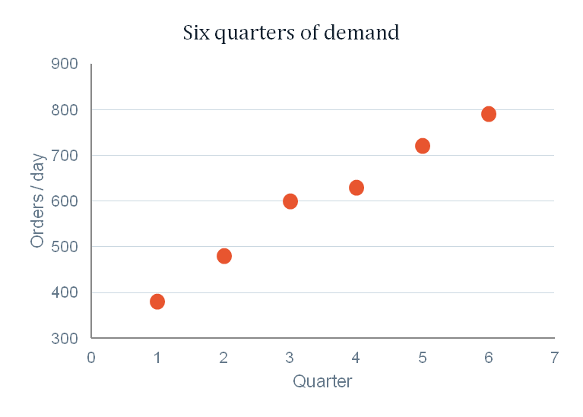
WORKED EXAMPLE 1 · STORE #2,443
Six quarters of orders
Average orders per day at the Gwalior dark store, by quarter since opening. Forecast the next three quarters so the rider-hiring plan can be signed off.
Quarter | Q1 | Q2 | Q3 | Q4 | Q5 | Q6
X (period) | 1 | 2 | 3 | 4 | 5 | 6
Y (orders/day) | 380 | 480 | 600 | 630 | 720 | 790
Look at the scatter before you compute anything.
The points rise, but not perfectly — Q3 sits above any straight line you could draw and Q4 sits below it. That gap is the whole reason we need a formula instead of a ruler: we need the one line that is least wrong across all six points, not the line that happens to touch the two you looked at first.
Roughly how many extra orders per day is this store adding each quarter?
Demand Forecasting
26

Slide 27
WORKED EXAMPLE 1 · STEP 1
Build the table, add four columns
X | Y | XY | X²
1 | 380 | 380 | 1
2 | 480 | 960 | 4
3 | 600 | 1800 | 9
4 | 630 | 2520 | 16
5 | 720 | 3600 | 25
6 | 790 | 4740 | 36
ΣX = 21 | ΣY = 3,600 | ΣXY = 14,000 | ΣX² = 91
b = [ 6(14,000) − (21)(3,600) ] ÷ [ 6(91) − 21² ]
= ( 84,000 − 75,600 ) ÷ ( 546 − 441 )
= 8,400 ÷ 105 = 80
a = [ 3,600 − 80(21) ] ÷ 6
= ( 3,600 − 1,680 ) ÷ 6 = 1,920 ÷ 6 = 320
a = 320
Ŷ = 320 + 80 X
Demand Forecasting
27

Slide 28
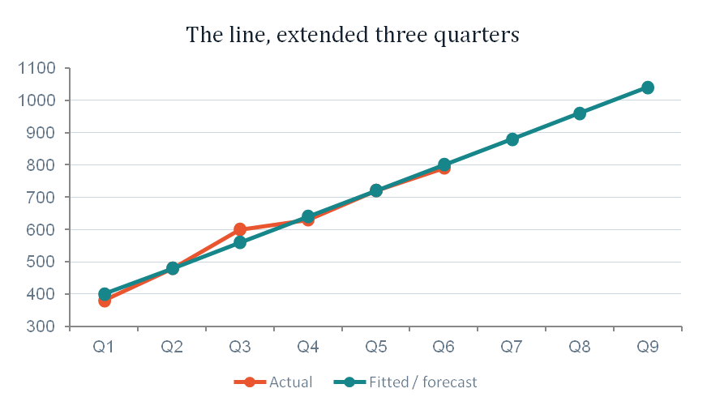
WORKED EXAMPLE 1 · STEP 2
Extend the line — and read it out loud
Quarter | X | Ŷ = 320 + 80X | Forecast orders/day
Q7 | 7 | 320 + 80(7) | 880
Q8 | 8 | 320 + 80(8) | 960
Q9 | 9 | 320 + 80(9) | 1,040
Say it in words, not symbols
b = 80 means this store adds about 80 orders per day every quarter. That sentence — not the equation — is what the operations head acts on. At roughly 25 deliveries per rider-shift, Q9's extra 250 orders/day over today is about 10 more rider-shifts to contract.
And the health warning: at X = 40 this same equation cheerfully forecasts 3,520 orders a day from a store with one freezer and a 2 km radius. A trend line has no idea what a ceiling is. Extrapolate two or three periods, not twenty.
Demand Forecasting
28

Slide 29
CRISIS 3
"Mango season. Push
the price up ₹50."
Head office wants the margin. You need to tell them what it costs in volume — and "time" is now the wrong X. Demand for mangoes is not drifting up with the calendar. It is responding to a price.
Same two formulas. Replace time with the cause. This is causal forecasting.
Crisis 3 · Price
29

Slide 30
CAUSAL FORECASTING
When X is not time
The arithmetic does not change at all. What changes is the claim you are making about the world — and that is a much bigger deal than it looks.
TIME-SERIES REGRESSION
CAUSAL REGRESSION
Ŷ = a + b (period)
Ŷ = a + b (price)
The claim: "whatever has been pushing demand up will keep pushing at the same rate."
You cannot act on it. Time is not a lever — you cannot pull harder on next quarter.
The claim: "this specific driver moves demand, by this much."
You CAN act on it. Price is a lever. That is why causal models are worth the extra trouble.
Demand Forecasting
30

Slide 31
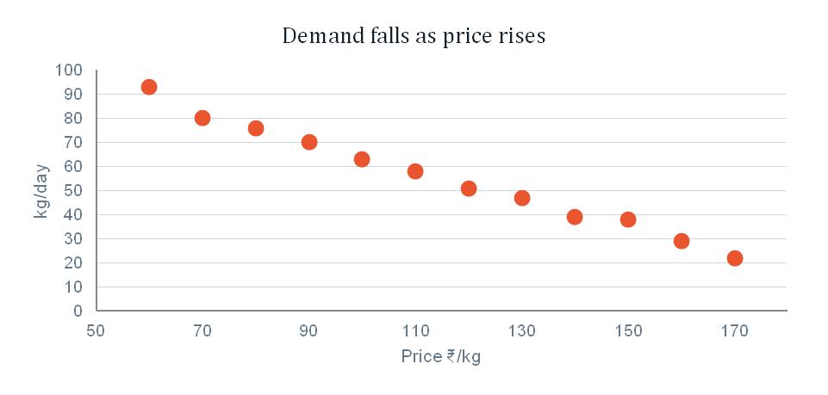
WORKED EXAMPLE 2 · MANGOES
Twelve prices, twelve outcomes
Over twelve days of mango season the store ran different price points (supply-driven, not deliberate experiments). Fit a regression line and estimate demand at ₹95/kg and ₹145/kg.
Price P (₹/kg) | 60 | 70 | 80 | 90 | 100 | 110 | 120 | 130 | 140 | 150 | 160 | 170
Sold Q (kg/day) | 93 | 80 | 76 | 70 | 63 | 58 | 51 | 47 | 39 | 38 | 29 | 22
The four sums (n = 12)
ΣP
1,380
ΣQ
666
ΣPQ
68,010
ΣP²
173,000
Demand Forecasting
31

Slide 32
WORKED EXAMPLE 2 · RESULT
The estimated demand curve
b = [12(68,010) − (1,380)(666)] ÷ [12(173,000) − 1,380²]
The two forecasts
= ( 816,120 − 919,080 ) ÷ ( 2,076,000 − 1,904,400 )
At P = ₹95: Q̂ = 124.5 − 0.60(95) = 124.5 − 57.0
= −102,960 ÷ 171,600 = −0.60
= 67.5 kg/day
At P = ₹145: Q̂ = 124.5 − 0.60(145) = 124.5 − 87.0
a = [ 666 − (−0.60)(1,380) ] ÷ 12 = 1,494 ÷ 12 = 124.5
= 37.5 kg/day
Now answer head office
The ₹50 increase buys ₹50 × 37.5 = ₹1,875/day of extra price revenue but gives up 30 kg of volume. Whether that is a win depends entirely on the margin per kg — which is a pricing decision, not a forecasting one. Your job was to supply the 30.
Q̂ = 124.5 − 0.60 P
b = −0.60 reads: every ₹1 on the price costs 0.6 kg a day
Demand Forecasting
32

Slide 33
MULTIPLE REGRESSION
When one driver is not enough
Real demand has several causes at once. Multiple regression handles two or more independent variables — the formulas stop being hand-calculable, but the interpretation does not change.
Ŷ = 310 − 0.6 X₁ + 1.9 X₂ + 140 X₃ + 2.4 X₄
An illustrative model for daily mango kg at one dark store:
X₁
Price, ₹/kg
Each ₹1 costs 0.6 kg — our causal result, now controlling for everything else.
X₂
Max temperature, °C
Each extra degree adds 1.9 kg. Weather is a real, forecastable driver.
X₃
Weekend (1 or 0)
A Saturday or Sunday adds 140 kg on its own.
X₄
App banner impressions, '000
Each thousand impressions adds 2.4 kg — the marketing team's contribution, quantified.
Demand Forecasting
33

Slide 34
CRISIS 4
April arrives, and
the freezer empties.
Your trend model is right on average and wrong every single month. It has no idea that April is not February.
Across Indian quick commerce in the summer of 2026, platforms reported ice cream more than doubling year on year, hand fans up 44×, cold coffee and mangoes up around 10× in a single week.
A trend line cannot see a season. You have to measure the season separately.
Crisis 4 · Seasonality
34

Slide 35
CRISIS 4 · THE CALENDAR
Time Series
Analysis
06
Pulling demand apart into trend, season, cycle and noise — then putting it back together into a forecast that knows what month it is.
Demand Forecasting
35

Slide 36
TIME SERIES ANALYSIS
Five components hiding in one line
A time series is a set of numbers where the ORDER matters. Analysis means separating out the patterns — because each one needs a different response from you.
Trend
A sustained upward or downward drift.
Gwalior adding ~80 orders/day each quarter.
Seasonality
A pattern that repeats within a year or less.
Ice cream peaks Apr–Jun, collapses Dec–Feb. Every year.
Cycle
A repeating pattern longer than a year.
The funding-and-expansion cycle in Indian quick commerce.
Irregular variation
A one-off shock that shifts the level.
A regulator bans your best-seller. Next slide.
Random fluctuation
Everything left over. Unexplained, unforecastable.
Tuesday was 8 cups low. There is no reason. Stop looking.
Demand Forecasting
36

Slide 37
IRREGULAR VARIATION · A TRUE STORY
In June 2015, India banned Maggi.
Nestlé India had roughly thirty years of beautifully behaved monthly sales data for the best-known packaged food in the country. Every model in this chapter would have fitted it well. Then, over five months, demand went to zero — not because customers changed their minds, but because a regulator ordered a recall.
₹320 crore
of Maggi stock destroyed
₹64.4 crore
quarterly loss — Nestlé India's first in 17 years
What this teaches, and it is not "models are useless"
5 months
No quantitative method forecasts a regulatory shock. Nothing in the history contains it. Stop expecting one to.
The damage was not the ban — it was the supply chain still running at pre-ban forecasts for weeks afterwards.
The right response to irregular variation is not a better model. It is a faster feedback loop and a plan for being wrong.
off the shelves, June to November 2015
75% → 60%
market share, before the ban and three years after
Nestlé's model was not broken — it was answering a question nobody had asked it. What should the demand planner have done on day 2 of the ban, with no data and no precedent?
Irregular variation · Maggi 2015
37

Slide 38
SEASONALIZED REGRESSION
Six steps: strip the season, fit, put it back
The logic is simple even though the arithmetic is long. A trend line cannot cope with a season, so we remove the season, fit the trend on clean data, forecast, and then re-apply the season.
1
Select a representative historical data set
2
Develop a seasonal index for each season
At least two full cycles — you cannot see a season you have only lived through once.
Each season's average ÷ the overall average. Above 1.0 = a strong season.
3
Deseasonalize the data
4
Run linear regression on the deseasonalized data
Divide each actual value by its own season's index. What is left is trend plus noise.
The same two formulas from slide 25. Nothing new.
5
Compute the deseasonalized forecasts
6
Reseasonalize the forecasts
Substitute the future periods into the fitted equation.
Multiply each forecast by its season's index. Now it knows what month it is.
Demand Forecasting
38

Slide 39
WORKED EXAMPLE 3 · STEPS 1–2
The data, and the seasonal indexes
Average ice cream tubs sold per day at store #2,443, over eight quarters. Indian financial year: Q1 = Apr–Jun (peak summer), Q4 = Jan–Mar (winter).
Quarter | Apr–Jun (Q1) | Jul–Sep (Q2) | Oct–Dec (Q3) | Jan–Mar (Q4) | Year total
Year 1 | 168 | 104 | 80 | 64 | 416
Year 2 | 204 | 128 | 100 | 80 | 512
Quarterly average | 186 | 116 | 90 | 72 | Overall avg = 116
Seasonal index | 1.603 | 1.000 | 0.776 | 0.621 | Σ = 4.000
Seasonal index = quarterly average ÷ overall average
Read the indexes as sentences
Q1: 186 ÷ 116 = 1.603 Q2: 116 ÷ 116 = 1.000
Q3: 90 ÷ 116 = 0.776 Q4: 72 ÷ 116 = 0.621
A summer quarter runs 60% above the year's average day. A winter quarter runs 38% below it. Q2 happens to land exactly on the average — which is a coincidence, not a rule.
The indexes must sum to the number of seasons: 4.000. Always check.
Demand Forecasting
39

Slide 40
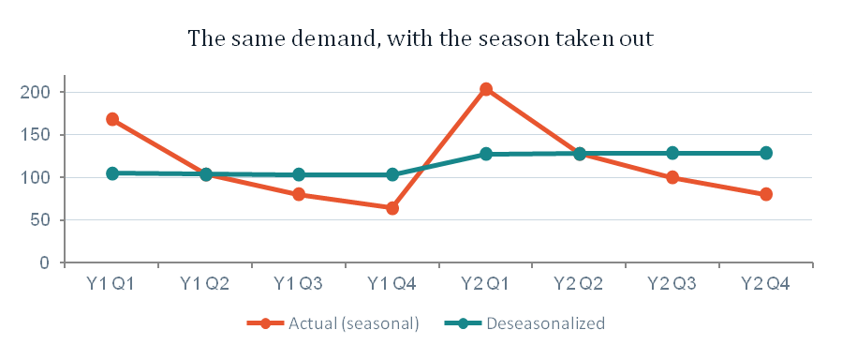
WORKED EXAMPLE 3 · STEPS 3–4
Deseasonalize, then fit the line
Deseasonalized value = actual sales ÷ that quarter's seasonal index
Period | Y1 Q1 | Y1 Q2 | Y1 Q3 | Y1 Q4 | Y2 Q1 | Y2 Q2 | Y2 Q3 | Y2 Q4
X | 1 | 2 | 3 | 4 | 5 | 6 | 7 | 8
Actual sales | 168 | 104 | 80 | 64 | 204 | 128 | 100 | 80
÷ index | 1.603 | 1.000 | 0.776 | 0.621 | 1.603 | 1.000 | 0.776 | 0.621
Deseasonalized Y | 104.8 | 104.0 | 103.1 | 103.1 | 127.3 | 128.0 | 128.9 | 128.8
Regress the deseasonalized series (n = 8)
ΣX = 36 ΣY = 928.0 ΣXY = 4,371.7 ΣX² = 204
b = [8(4,371.7) − 36(928.0)] ÷ [8(204) − 36²]
= 1,565.6 ÷ 336 = 4.660
a = [928.0 − 4.660(36)] ÷ 8 = 95.032
Ŷ = 95.032 + 4.660 X
Demand Forecasting
40

Slide 41
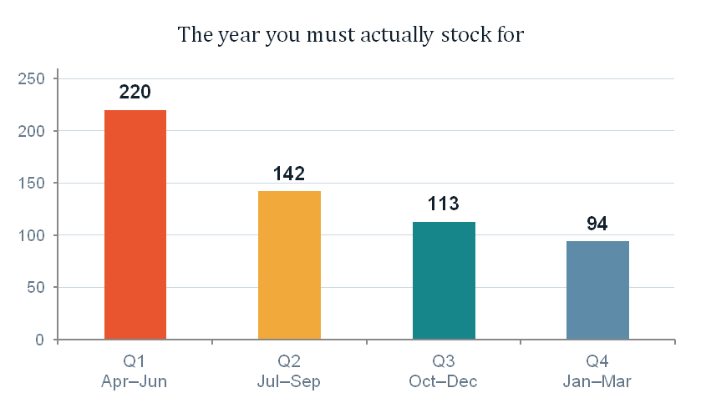
WORKED EXAMPLE 3 · STEPS 5–6
Forecast, then put the season back
Year 3 | X | Deseasonalized Ŷ = 95.032 + 4.660X | × index | Forecast tubs/day
Q1 Apr–Jun | 9 | 136.97 | 1.603 | 220
Q2 Jul–Sep | 10 | 141.63 | 1.000 | 142
Q3 Oct–Dec | 11 | 146.29 | 0.776 | 113
Q4 Jan–Mar | 12 | 150.95 | 0.621 | 94
Two numbers in this table are doing all the work
The deseasonalized trend crawls from 137 to 151 across the whole year — a quiet 10% of underlying growth. The forecast you actually act on swings from 220 down to 94, a fall of 57%.
The trend is the business. The index is the year. Confuse them and you will staff the freezer for a business that does not exist in January.
Demand Forecasting
41

Slide 42
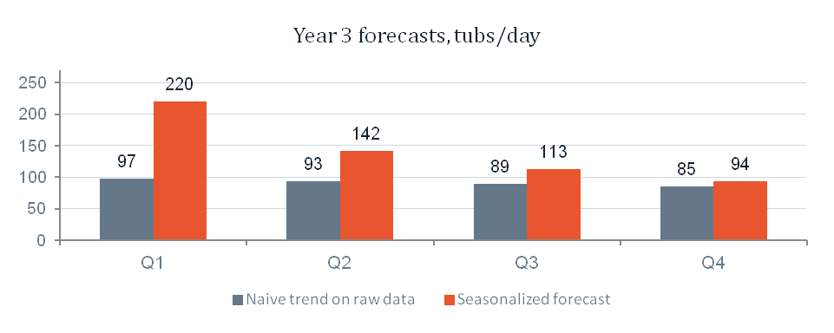
WHY WE BOTHERED
The same data, two models, opposite conclusions
Suppose we had skipped all of that and simply run the regression from slide 25 straight onto the raw seasonal data. Here is what it returns.
Raw regression, no deseasonalizing
Seasonalized regression, done properly
Ŷ = 134.86 − 4.19 X
Ŷ = 95.03 + 4.66 X
Slope NEGATIVE. "Ice cream at this store is dying at 4.2 tubs a quarter. Cut the freezer."
Slope POSITIVE. "Underlying demand is growing at 4.7 tubs a quarter. Expand the freezer."
Why the sign flips
The series begins on a summer peak (168) and ends on a winter trough (80). A straight line drawn through that runs downhill — it is measuring the calendar, not the business.
In peak summer the naive model orders 97 tubs against real demand near 220. Your freezer is empty by 11 a.m. every day for three months, and no report anywhere will tell you the model was the reason.
Demand Forecasting
42

Slide 43
PRACTICE QUESTION
Now you do one — cold drinks, Guna store
Cases of cold drinks sold per day at the Guna store over eight quarters. Work through all six steps and forecast Year 3. Same method, new numbers.
Quarter | Apr–Jun (Q1) | Jul–Sep (Q2) | Oct–Dec (Q3) | Jan–Mar (Q4)
Year 1 | 90 | 126 | 72 | 60
Year 2 | 114 | 156 | 90 | 72
Notice before you start
The peak here is Q2 (Jul–Sep), not Q1. Cold drinks in central India sell hardest through the humid end of summer and into the monsoon, not the dry heat of April.
If you assume the ice cream pattern applies, you will get four indexes that sum to 4.000 and are still completely wrong. The method does not know which season is which. You do.
Your checklist
Overall average, then the four quarterly averages, then four indexes. Do they sum to 4.000?
Deseasonalize all eight values. Keep three decimals.
Regress on X = 1…8. Report a and b to three decimals.
Forecast X = 9…12, then multiply each by its index.
One sentence of interpretation: is this business growing, and by how much per quarter?
Demand Forecasting
43
Notes:
ANSWER KEY — practice question (cold drinks, Guna).
Overall average = 97.5.
Quarterly averages: Q1 = 102.0, Q2 = 141.0, Q3 = 81.0, Q4 = 66.0.
Seasonal indexes: Q1 = 1.046, Q2 = 1.446, Q3 = 0.831, Q4 = 0.677. Sum = 4.000.
Deseasonalized series (X = 1..8): 86.04, 87.14, 86.64, 88.63, 108.99, 107.88, 108.30, 106.35.
Sums: SX = 36, SX2 = 204, SY = 779.97, SXY = 3,675.89.
b = [8(3675.89) - 36(779.97)] / [8(204) - 36^2] = 1,328.28 / 336 = 3.953
a = [779.97 - 3.953(36)] / 8 = 79.708
Fitted: Y = 79.708 + 3.953X
Deseasonalized forecasts: X=9 -> 115.28, X=10 -> 119.24, X=11 -> 123.19, X=12 -> 127.14.
Reseasonalized Year 3 forecasts (cases/day): Q1 = 120.6, Q2 = 172.4, Q3 = 102.4, Q4 = 86.1.
Interpretation: underlying demand is growing about 3.95 cases per day per quarter, i.e. roughly 4% a quarter off a base near 100. The Q2 index of 1.446 means the monsoon-end quarter runs 45% above an average day.

Slide 44
CRISIS 5
It is Tuesday.
It is 44°C.
Everything we have built so far answers questions about quarters and years. None of it helps you decide how much curd to order in the next forty minutes.
At a one-day horizon, trend contributes almost nothing, the seasonal index barely moves, and random fluctuation is most of what you are looking at.
Short-range forecasting: three methods, and one dial that controls all of them.
Crisis 5 · Tomorrow
44

Slide 45
CRISIS 5 · THE NEXT 24 HOURS
07
Short-Range
Methods
Moving average, weighted moving average, exponential smoothing — and the one trade-off that separates them.
Demand Forecasting
45

Slide 46
MATCHING THE WINDOW
Three horizons, three different problems
Short-term
Medium-term
Long-term
0 – 3 months
3 months – 2 years
More than 2 years
Random fluctuation dominates. Trend, cycle and seasonality barely register. You need responsiveness.
Seasonality and near-term trend become the main signals worth modelling.
Trend and structural change dominate. Nobody can tell you what next Tuesday looks like.
Moving average · exponential smoothing
Seasonalized regression · time series
Regression · executive consensus · Delphi
This is the single most common mistake in practice: using a long-range method for a short-range decision because it is the model the company already owns. A sophisticated annual model will tell you, with total confidence, the wrong number for tomorrow.
Demand Forecasting
46

Slide 47
SIMPLE MOVING AVERAGE
Average the last n days. That is the whole idea.
MA_n = ( ΣDᵢ ) ÷ n where Dᵢ is demand in period i
"Simple"
every one of the n periods is weighted equally — yesterday counts exactly as much as the day before it.
"Moving"
as a new day's demand arrives, the oldest day drops out. The window slides forward.
Choosing n IS the model
there is no other parameter. Pick n and you have picked everything.
Increase n
Decrease n
Smoother forecast. Noise gets dampened. But the forecast reacts slowly to a genuine change — LOW impulse response, HIGH noise dampening.
Twitchy forecast. Reacts fast to a real shift — but also chases every meaningless wobble. HIGH impulse response, LOW noise dampening.
Demand Forecasting
47

Slide 48
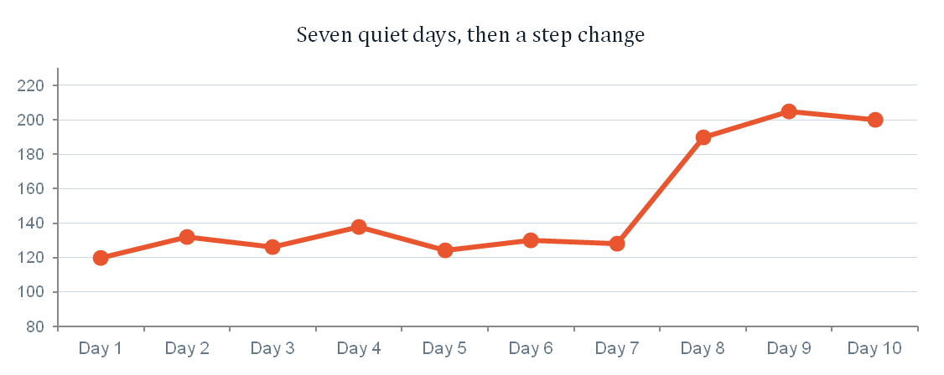
WORKED EXAMPLE 4 · TEN DAYS OF CURD
The data — and the day everything changes
400 g curd cups sold per day at store #2,443. On Day 8 a heatwave warning went out and the maximum temperature crossed 44°C.
 | Day 1 | Day 2 | Day 3 | Day 4 | Day 5 | Day 6 | Day 7 | Day 8 | Day 9 | Day 10
Cups sold | 120 | 132 | 126 | 138 | 124 | 130 | 128 | 190 | 205 | 200
Two things are happening at once
Days 1–7 wobble between 120 and 138. That is random fluctuation. There is no pattern to find in it, and any model that thinks it found one is fooling you.
Day 8 is not a wobble. It is a step change to a new level, and it is going to persist while the heat does.
Your model has to ignore the first kind of movement and react to the second kind — using nothing but the numbers, with no idea what a heatwave is.
?? Standing on the evening of Day 8, looking only at the numbers: is 190 a new level, or a freak day? What would you order for Day 9 — and what would it cost you to be wrong either way?
Demand Forecasting
48

Slide 49
WORKED EXAMPLE 4a
Three-day vs five-day moving average
Forecast for | MA₃ calculation | MA₃ | MA₅ calculation | MA₅ | Actual
Day 6 | (126+138+124)/3 | 129.3 | (120+132+126+138+124)/5 | 128.0 | 130
Day 7 | (138+124+130)/3 | 130.7 | (132+126+138+124+130)/5 | 130.0 | 128
Day 8 | (124+130+128)/3 | 127.3 | (126+138+124+130+128)/5 | 129.2 | 190
Day 9 | (130+128+190)/3 | 149.3 | (138+124+130+128+190)/5 | 142.0 | 205
Day 10 | (128+190+205)/3 | 174.3 | (124+130+128+190+205)/5 | 155.4 | 200
Day 11 | (190+205+200)/3 | 198.3 | (130+128+190+205+200)/5 | 170.6 | ?
The Day 8 miss
What happens next is the real test
Both models forecast about 128 and demand arrived at 190. You were 62 cups short — roughly a third of the day's demand walked out unfilled, and neither model did anything wrong. No moving average can forecast a change before it happens.
By Day 11, MA₃ has climbed to 198 and MA₅ has only reached 171. The short window has already forgotten the cool days; the long one is still averaging them in. Same data, 28 cups apart.
Demand Forecasting
49

Slide 50
WORKED EXAMPLE 4b · WEIGHTED MOVING AVERAGE
Stop pretending all days matter equally
WMA = Σ CᵢDᵢ where ΣCᵢ = 1.0
Same window as MA₃, but the three days no longer count the same. Weights must sum to exactly 1.0 and generally decline with the age of the data.
Day | Demand Dᵢ | Weight Cᵢ | CᵢDᵢ
Day 8 (oldest) | 190 | 0.20 | 38.0
Day 9 | 205 | 0.30 | 61.5
Day 10 (most recent) | 200 | 0.50 | 100.0
Total | — | 1.00 | 199.5
Forecast for Day 11
199.5 → order 200 cups
Compare: MA₃ gave 198.3 and MA₅ gave 170.6.
The weights bought us almost nothing over MA₃ here — because all three days in the window are already at the new level. Weighting matters most in the two or three periods right after a shift, when the window still contains both worlds.
Demand Forecasting
50

Slide 51
EXPONENTIAL SMOOTHING
Use all of history, but forget it gradually
Moving averages throw data away. The last-period method uses one day; MA₃ uses three and discards everything older. Exponential smoothing keeps every observation ever recorded, giving each one less weight the further back it sits.
Fₜ = w Aₜ₋₁ + ( 1 − w ) Fₜ₋₁
w
Aₜ₋₁
Fₜ₋₁
Fₜ
the smoothing constant, between 0 and 1 — the only thing you choose
what actually happened last period
what you forecast for last period
the forecast for the period coming up
Demand Forecasting
51

Slide 52
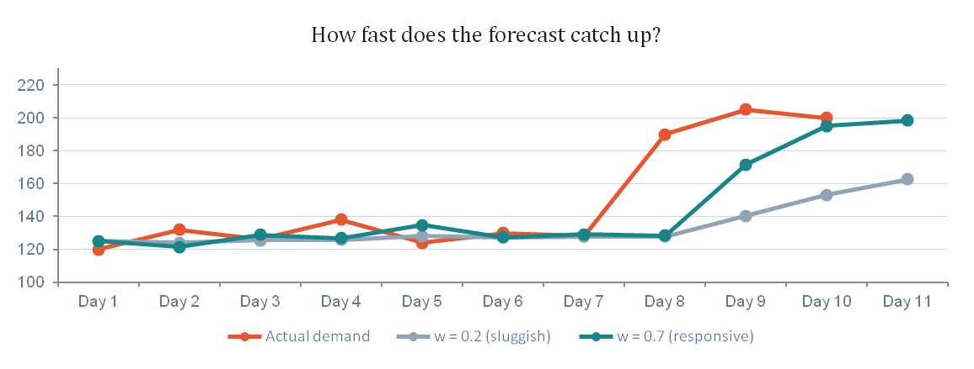
WORKED EXAMPLE 4c
Same ten days, two smoothing constants
Starting both at F₁ = 125 cups. Watch what happens on Day 8, and how long each one takes to catch up.
 | Day 1 | Day 2 | Day 3 | Day 4 | Day 5 | Day 6 | Day 7 | Day 8 | Day 9 | Day 10 | Day 11
Actual Aₜ | 120 | 132 | 126 | 138 | 124 | 130 | 128 | 190 | 205 | 200 | ?
Fₜ (w = 0.2) | 125.0 | 124.0 | 125.6 | 125.7 | 128.1 | 127.3 | 127.9 | 127.9 | 140.3 | 153.2 | 162.6
Fₜ (w = 0.7) | 125.0 | 121.5 | 128.9 | 126.9 | 134.7 | 127.2 | 129.2 | 128.4 | 171.5 | 195.0 | 198.5
Sample calculation
F₉ (w = 0.7)
= 0.7(190) + 0.3(128.4)
= 133 + 38.5 = 171.5
The cost of w = 0.2
Three full days after the heatwave began, it is still forecasting 163 against demand near 200. Every one of those days is a stockout — and w = 0.2 will keep being wrong for another week.
Demand Forecasting
52

Slide 53
THE SHOWDOWN
Five methods, one question: how many cups for Day 11?
MA₅
170.6
Still averaging in two cool days
DAY 11 ACTUAL
212 cups
Exp. smoothing, w = 0.2
162.6
Correcting only 20% of its error each day
The heat held.
MA₃
198.3
Window now fully inside the heatwave
Cups short, Day 11
Exp. smoothing, w = 0.7
198.5
Has effectively caught up
Weighted MA
13
Exp. w = 0.7
14
Weighted MA (0.2/0.3/0.5)
199.5
Leans hardest on the most recent day
MA₃
14
MA₅
41
Exp. w = 0.2
49
The honest lesson: the two "stable" methods lost you about 45 cups of sales on one day at one store. Multiply by 2,443 stores and a three-month summer and you are looking at the other half of that ₹308 crore — the half that never shows up in any write-off report, because unsold demand leaves no inventory behind to count.
Demand Forecasting
53

Slide 54
THE ONE TRADE-OFF
Everything in this section is the same dial
Small n, heavy recent weights, large w — these are three names for turning the dial one way. Large n, flat weights, small w turn it the other way. There is no setting that is simply better.
TURN IT UP
TURN IT DOWN
High impulse response
High noise dampening
Small n · steep weights · large w
Large n · flat weights · small w
Catches a real change fast
Chases noise and over-corrects
Right when demand genuinely shifts: weather, festivals, a competitor closing
Ignores meaningless wobble
Slow to notice a genuine shift
Right when demand is stable and the cost of over-reacting is high: slow-moving stock, long lead times
So the setting is not a statistics question. It is a question about your product: how volatile is real demand, and which of the two errors costs you more? Curd and ice cream want a responsive model. Batteries and detergent do not.
Demand Forecasting
54

Slide 55
CRISIS 6 · THE $400 MILLION MISTAKE
Choosing the
Right Method
08
Six criteria, one trade-off you cannot escape, and the most expensive forecasting failure in corporate history.
Demand Forecasting
55

Slide 56
SELECTION CRITERIA
Six factors that decide the method
1
Cost
2
Accuracy
3
Data available
What can this decision justify spending? A ₹40,000 order does not deserve a ₹4 crore model.
How much error can the decision downstream actually tolerate before it breaks?
Can the data the method needs be obtained at all, at a price worth paying?
4
Time span
5
Nature of the product
6
Impulse response
Short, medium or long range — this alone rules out most of the toolkit.
Cost, volume, life-cycle stage, perishability, seasonality of demand.
How fast should this forecast react to a genuine change in demand?
In practice #3 decides it. You will spend most of your career discovering that the method you wanted needs data nobody collected, and choosing the second-best method that runs on the data you actually have.
Demand Forecasting
56

Slide 57
COST vs ACCURACY
More accuracy is always available — at a price
This is the trade-off nobody escapes. More accuracy is purchasable; the question is whether this decision is worth the purchase.
What high accuracy costs you
Low / moderate cost
High cost
Uses more data — which has to exist
That data is harder and costlier to obtain
The models cost more to design, build and run
They take longer to use, every single cycle
Statistical models
Historical analogies
Executive-committee consensus
Complex econometric models
The Delphi method
Commissioned market research
The test to apply, every time
What does one percentage point of extra forecast accuracy earn on this decision? For tonight's curd order at one store, a few hundred rupees — so spend nothing. Across 2,443 stores and a year of perishables, that same percentage point is worth crores — so spend properly. Same method, same maths, completely different answer, because the decision changed.
Demand Forecasting
57

Slide 58
CRISIS 6 · A TRUE STORY
Nike bought the best
forecasting system
money could buy.
In 2000 Nike installed a demand-planning system from i2 Technologies as part of a supply-chain project reported at around $400 million. It was state of the art. The consultants were excellent. The mathematics was not in question.
By February 2001 it had cost them over $100 million in lost sales.
Crisis 6 · Nike 2001
58

Slide 59
WHAT ACTUALLY WENT WRONG
It over-ordered one shoe and lost orders for another
$100m+
in lost sales, disclosed February 2001
"This is what you get for $400 million, huh?"
20%
fall in the share price
— Phil Knight, Nike co-founder and then chairman
Air Garnett
over-ordered — the model bought shoes nobody wanted
Air Jordan
orders lost or deleted — the shoe everybody wanted
The real diagnosis
The software predicted consumption by analysing demand history. But Nike's business ran on retailers committing to orders six months ahead — so the number that mattered was an order book, not a predicted pattern. The model was answering a question Nike's business model never asked.
By spring 2001 Nike had pulled short- and medium-range sneaker planning out of the system and moved it onto order and invoice data instead.
Source: CIO Magazine, "Nike Rebounds: How (and Why) Nike Recovered from Its Supply Chain Disaster".
Demand Forecasting
59

Slide 60
THE LESSON
Step 1 of the process was the step they skipped
Go back to slide 10. The four steps were: specify the objective, choose the method, collect the data, estimate and interpret. Nike started at step two.
Nobody asked what was being forecast
1
Consumption by end customers, or orders placed by retailers? Those are different quantities with different data and different methods. The project was well underway before the difference mattered — and by then it was a $100 million question.
The method was chosen before the objective
2
A powerful predictive engine was bought first and pointed at the business afterwards. The order is not decorative; reverse it and you get a beautiful model of the wrong thing.
Nobody was measuring the error in time
3
The gap between forecast and reality ran for months before it surfaced as a disclosure. A forecast nobody scores is a forecast nobody can correct.
Nike recovered — revenue and share price came back, and the wider project was later judged a success. The $100 million was the tuition fee for learning that a forecasting method is a claim about how your business works, not a piece of software you install.
Demand Forecasting
60

Slide 61
GETTING IT WRONG
Six reasons forecasts fail — and where we saw each one
1
Narrow involvement
2
Treated as an afterthought
Not involving a broad cross-section of people.
Not recognising forecasting as integral to business planning.
The riders knew things the spreadsheet did not.
Nike bought the tool before asking what it was forecasting.
3
Expecting perfection
4
Forecasting the wrong thing
Not accepting that forecasts will always be wrong to some degree.
Not forecasting what the decision actually needs.
A range, not a number. Slide 14.
Retailer orders vs consumer demand. That was the $100 million.
5
Wrong method for the situation
6
No feedback loop
Not matching method to horizon, data and product.
Not tracking forecast accuracy over time.
A trend line for tomorrow's curd. A raw regression on seasonal data.
Maggi: the damage was the weeks of ordering after the ban began.
Demand Forecasting
61

Slide 62
TOOLS
What this actually runs on, in practice
Dedicated forecasting
Statistics & ERP
What most people use
Forecast Pro
Autobox
SmartForecasts
SAS · SPSS · R
SAP · Oracle
POM software library
Excel.
Every formula in this chapter is a spreadsheet column. The tools above matter when you are forecasting 6,000 SKUs across 2,443 stores — not before.
Demand Forecasting
62

